Slide 1

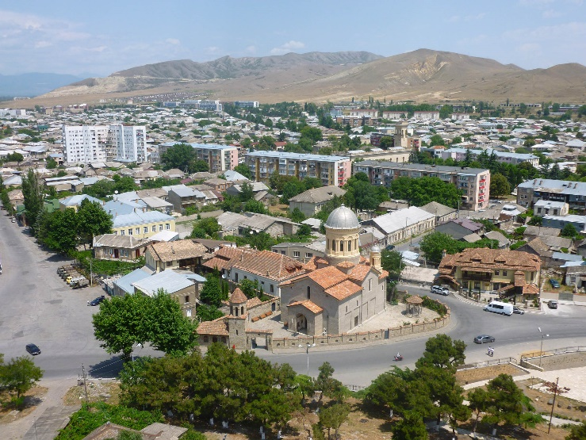
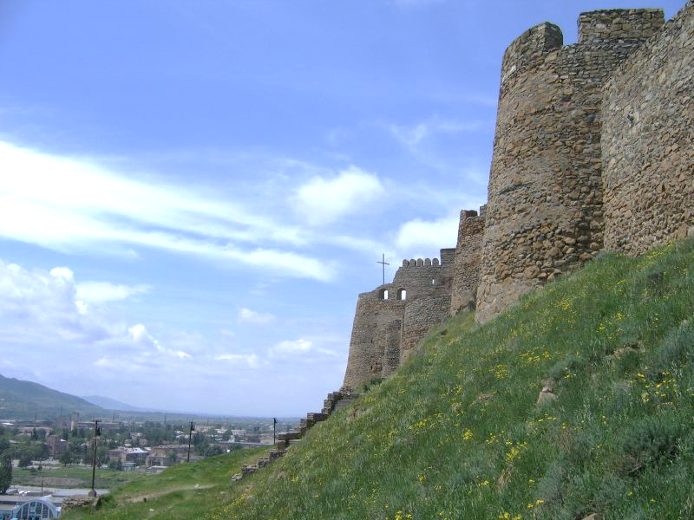
Gori Valley
A DCS Word
Multi Player
Combat Mission
Blue Team Briefing
Primary Mission: Eliminate Russian SA-6 installations
Tactical Mission: Rescue secret agent
Operational Mission: Sling load cargo to Gori
Operational Mission: Deploy NATO engineers to activate Patriots
Next Page ➔

Slide 2
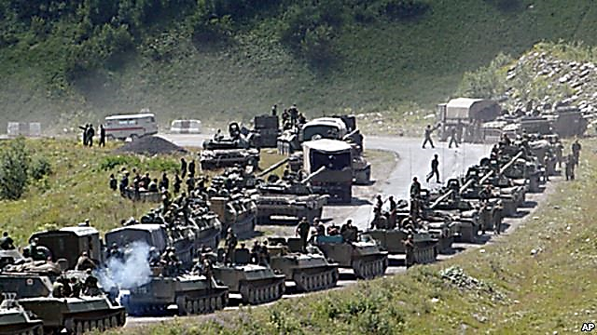
Situation
Russia has settled within the Georgian town Tskinvali and is prepared for an invasion towards Gori in the south-east. NATO is assisting Georgia to defend Gori and its valley from the Russian intruders.
NATO has installed 3 patriot air defense installations and has infantry and air defenses located near Gori and a bit further north near the town Kvarhiti.
NATO air support is provided from 2 major Georgian airbases in Kutaisi and the Tbilisi area.
Next Page ➔

Slide 3

Situation
Russia
NATO
Nal’chik air threats
Beslan air threats
Russian Infantry to Capture GORI
Bulls: Tskinvali
Front-Line
NATO Infantry to Defend GORI
Tbilisi air defenses
Kutaisi air support
Tbilisi air support
Bulls: Gori
Next Page ➔

Slide 4
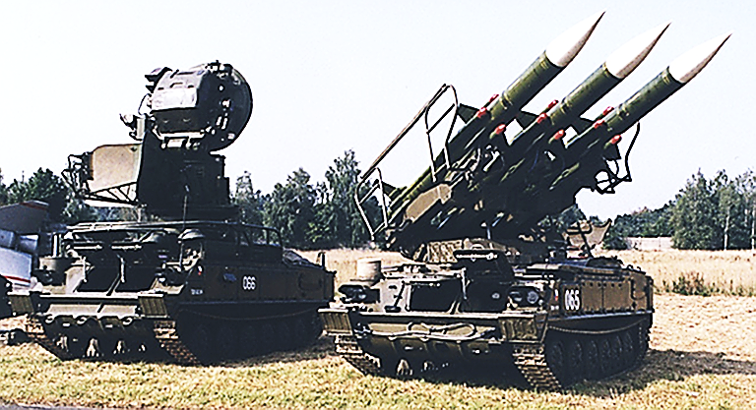

Primary Mission
Eliminate 3 Russian SA-6 air defense installations.
Russia has 3 large 2K12 "Kub“ (SA-6 Gainfull) medium to long range air defense installations deployed near Tskinvali.
NATO needs to destroy these air defenses to obtain full control of the airspace above Gori Valley. After elimination of these SA-6 installations, NATO will increase its air defenses.
Note: It is our ultimate priority to eliminate these installations before taking other actions.
Estimated locations of the SA-6 installations
Next Page ➔

Slide 5
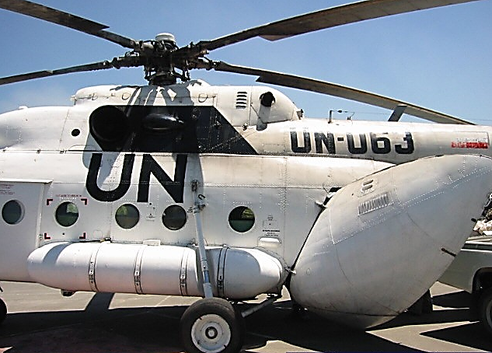

Tactical Mission
Rescue secret agent behind the enemy lines.
An important agent had to hide into the woods due to the Russian occupation of Tskinvali. NATO needs to rescue this agent to ensure NATO defenses. This agent has important information on the exact locations of strategic communication points of the Russian invader. Once we have rescued our secret agent, we will know the exact location of these units to stop further deployment of Russian troops within the battle field.
Estimated location of secret agent.
Rescue mission
Gori helicopter FARPs
Next Page ➔

Slide 6
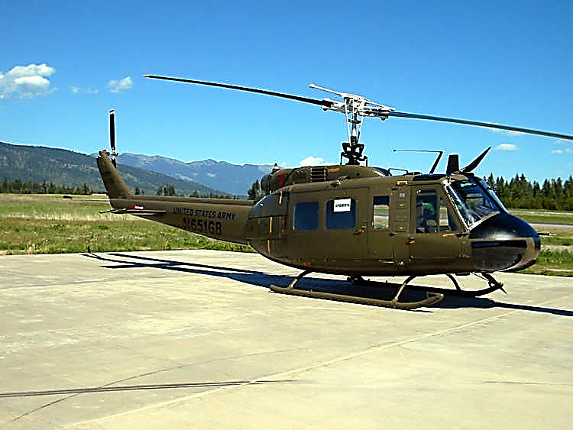

Operational Mission
Sling load cargo from 2 Georgian towns to Soganlug.
Important cargo packages are located within 2 Georgian villages: Kaspi and Dzegvi. NATO needs to transport these cargos back to Soganlug to ensure the safety of important documents and historical artifacts. Once these packages are deployed at the Soganlug drop zone, our transport trucks will load these cargos and will relocate them to Tbilisi city.
2 Georgian villages
NATO heli FARPS
Cargo
Drop zone
Next Page ➔

Slide 7
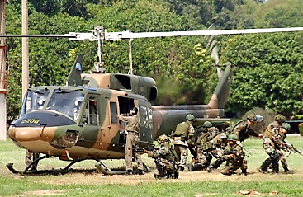

Operational Mission
Transport engineers from Kvarhiti to activate the 3 Patriot Batteries.
3 Patriot batteries are awaiting activation by radar control engineers.
Use the UH-1H helicopters to load the engineers from 2 coordination centers for redeployment: “Gold” and “Titan”. Once the engineers are loaded, fly to one of the 3 Patriot battery landing zones. Your co-pilot will provide you with directions during flight towards the Patriot installations. Deploying engineers to an activated Patriot installation will repair the installation.
NATO heli FARPS
Patriots
Next Page ➔

Slide 8

Mission End
NATO wins when all the BLUE Coalition Missions are completed and NATO forces have arrived at Tskinvali.
Russia wins when all the RED Coalition Missions are completed, and Russian forces have arrived at Gori.
Successful force arrival requires at least 10 vehicles within the target zone.
Duration of Mission: 4 hours until mission reset.
Next Page ➔

Slide 9
Gori Valley
A DCS Word
Multi Player
Combat Mission
Red Team Briefing
Primary Mission: Eliminate NATO Patriot installations
Tactical Mission: Rescue Russian general
Operational Mission: Deliver package to a secret location
Operational Mission: Deploy Russian engineers to activate SA-6
Next Page ➔

Slide 10
Situation
Russia has settled within the Georgian town Tskinvali and is prepared for an invasion towards Gori in the south-east. NATO is assisting Georgia to defend Gori and its valley from the Russian intruders.
Russia has installed 3 SA-6 air defense installations and has infantry and air defenses located near Tskinvali and on the nearby hills.
Russian air support is provided from 3 major Russian airbases in Nalchik, Beslan and Mozdok.
Next Page ➔

Slide 11
Situation
Russia
NATO
Nal’chik air threats
Beslan air threats
Russian Infantry to Capture GORI
Bulls: Tskinvali
Front-Line
NATO Infantry to Defend GORI
Tbilisi air defenses
Kutaisi air support
Tbilisi air support
Bulls: Gori
Next Page ➔

Slide 12
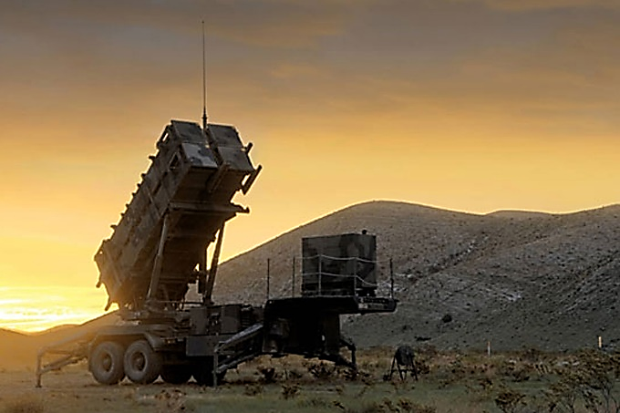
Primary Mission
Eliminate 3 Patriot air defense installations.
NATO has 3 Patriot long range air defense installations deployed near Tskinvali.
Russia needs to destroy these air defenses to obtain full control of the airspace above Gori Valley. After elimination of these Patriot installations, Russia will increase its air defenses.
Note: It is our ultimate priority to eliminate these installations before other actions are taken.
Estimated locations of the Patriot installations
Next Page ➔

Slide 13
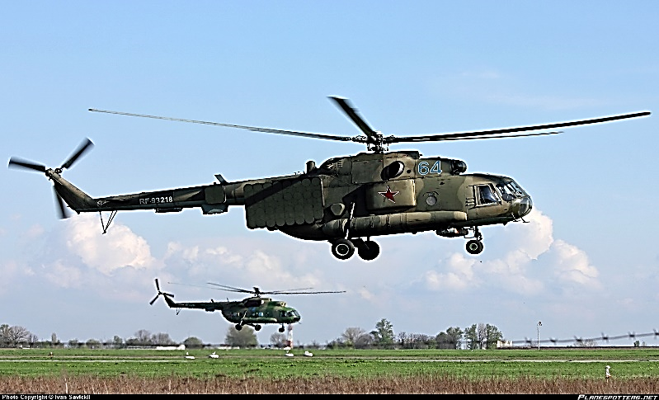
Tactical Mission
Rescue our Russian general behind the NATO enemy lines.
An important general was captured by NATO near Gori when he was on “vacation”. Russia needs to rescue our general to avoid NATO obtaining detailed information on secret locations of our troop supplies. If we are not rescueing him on time, NATO will have a much stronger defense to our final invasion efforts. We estimate we have about 1,5 hour time to rescue him!
Tskinvali helicopter FARPs
Rescue mission
Estimated location of our general.
Next Page ➔

Slide 14
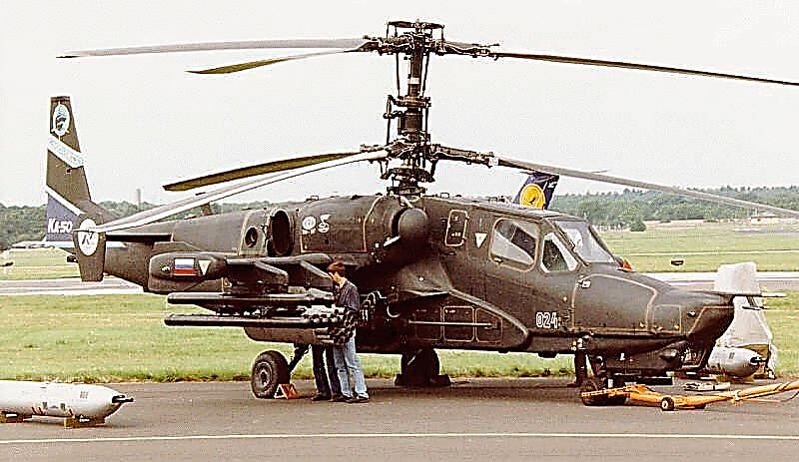
Operational Mission
Deliver secret package behind enemy lines.
Russia needs to deliver a very important package to a secret agent located near Gori. Note that we must deliver this package with care and it should not be lost! Penetrate enemy lines and remain undetected. Fly low and stay low, avoid any engagement with the enemy. Deliver the package and return to the home base in Tskinvali.
Tskinvali helicopter FARPs
Package delivery
Location of our secret agent.
Next Page ➔

Slide 15
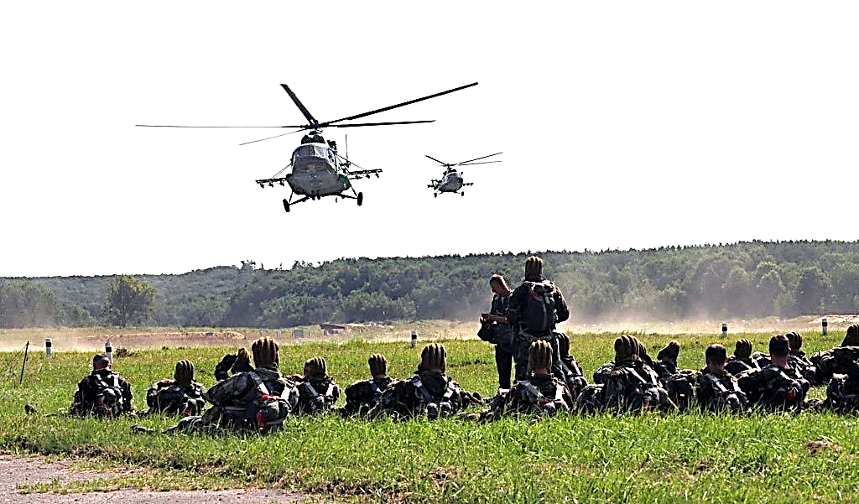
Operational Mission
Transport engineers from Tskinvali to activate the SA-6 launchers.
3 SAM SA-6 batteries are awaiting activation by launcher control engineers. Use the MI-8 helicopters to load our engineers from 2 pick-up centers “Alpha” and “Beta”. Once the engineers are loaded in your helicopter, fly to one of the 3 SA-6 launcher sites. Your co-pilot will provide you with directions during flight towards these SA-6 installations. Deploying engineers at an activated SA-6 installation will repair it.
Tskinvali helicopter FARPs
Location of
SA-6 launchers
Next Page ➔

Slide 16
Mission End
NATO wins when all the BLUE Coalition Missions are completed and NATO forces have arrived at Tskinvali.
Russia wins when all the RED Coalition Missions are completed, and Russian forces have arrived at Gori.
Successful force arrival requires at least 10 vehicles within the target zone.
Duration of Mission: 4 hours until mission reset.
Next Page ➔

Slide 17
General information
Scoring System
This multi player mission contains a new scoring mechanism which is tracking and logging the players achievements and collateral damage caused:
Show the scoring through the COMMUNICATIONS MENU (F10):
-> Scoring -> Report all Player Scores
-> Report current Player Log (not implemented yet)
Event | Score |  | Penalty
Hit Unit | Enemy | +1 | Friendly | -5
Kill Unit | Enemy | +10 | Friendly | -25
Change |  |  | Coalition | -50
Achieve | Mission Task | +25
Complete | Mission | +100 (each player who contributed)
Next Page ➔

Slide 18
General information
Scoring System
Show the scoring through the COMMUNICATIONS MENU (F10):
-> Scoring -> Report all Player Scores
Player scores are displayed for all active players when selected:
Player Scores:
Player ‘Player Name’ = Total Score (Score, -Penalty)
Depending on the achievements of the player, this line is completed with the event summaries for Ground Units, Planes, Helicopters, Ships, Tasks, Missions, Coalition Penalties:
Coalition: Hits: (Score;-Penalty)(#Hits;-#Hits) Kills: (Score;-Penalty) (#Kills;-#Kills)
Helicopter: Hits: (Score;-Penalty)(#Hits;-#Hits) Kills: (Score;-Penalty) (#Kills;-#Kills)
Plane: Hits: (Score;-Penalty)(#Hits;-#Hits) Kills: (Score;-Penalty) (#Kills;-#Kills)
Ship: Hits: (Score;-Penalty)(#Hits;-#Hits) Kills: (Score;-Penalty) (#Kills;-#Kills)
Tasks: Score Mission: Score ( ‘Mission Name(s)’ )
Coalition: -Penalty (# changes)
Next Page ➔

Slide 19
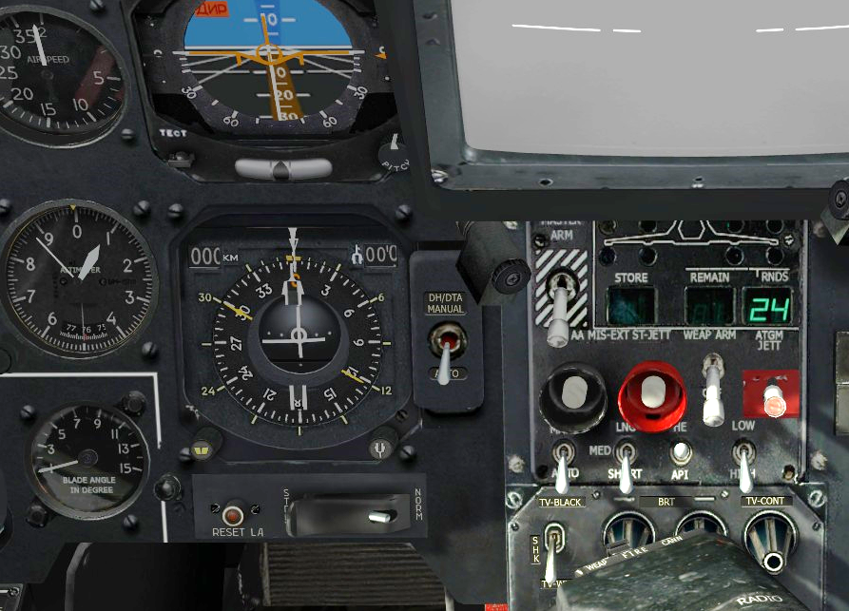
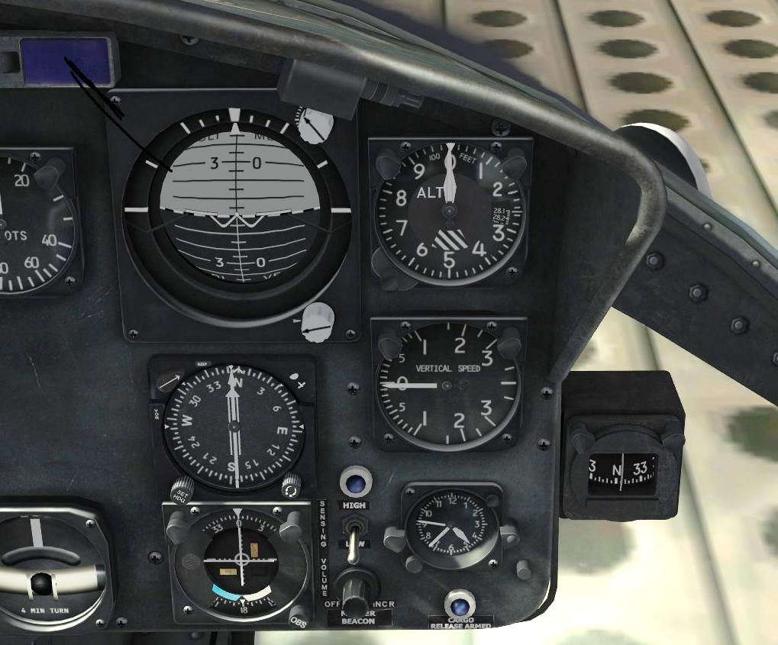
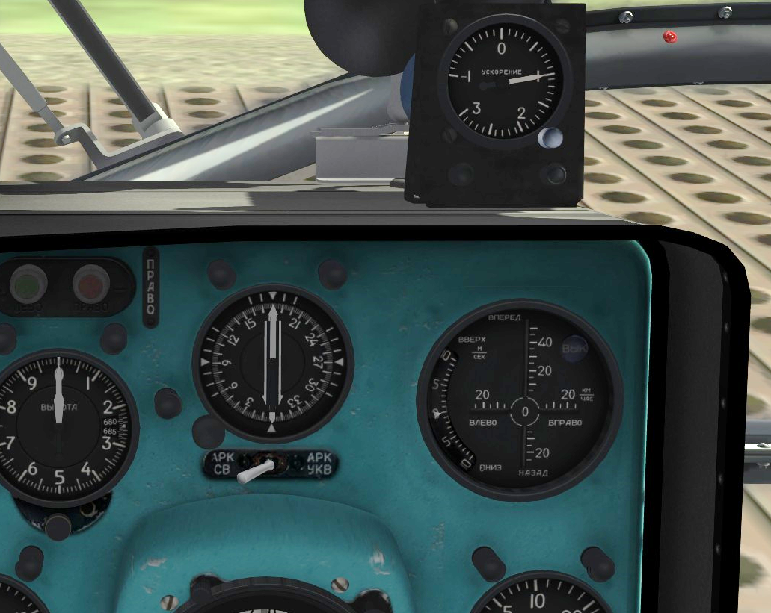
General information
Flight directions
UH-1H
KA-50
Radio compass indicators
Your co-pilot will indicate directions of flight in terms of the angle in degrees of the direction to fly, and the distance in km to the zone. Your helicopter is equipped with a radio compass indicator instrument, that provides you with the heading of your helicopter. Use this instrument to turn your helicopter to the correct zone.
MI-8
Next Page ➔

Slide 20
General information
Cargo
The different cargos that can be transported within this mission have a ‘type’, a ‘weight’ in kg, and a ‘state’.
Cargo ‘types’ can be Infantry, Packages, Sling Loads and Vehicles. Depending on the type of cargo, the communication menu will show a different menu for each cargo type that is available. Ensure that you select the correct cargo type within the correct communicaton menu to load/unload the correct cargo type, to accomplish your mission objectives!
The weight of a cargo does not yet influence the helicopter flight characteristics. However, expect in future versions also this to be taken care off, adding more realism.
Each cargo has a ‘state’, so that within the mission, the actions done with each cargo element will determine mission success or failure. Beware of this while flying a mission. F.e., if a cargo needs to be loaded/unloaded once, ensure that the cargo will be handled in this way. When flying a helicopter that is assigned for transport, you will receive a message containing the exact cargo contents within the helicopter. Note that when your helicopter crashes, the cargo will be LOST within the mission, and your mission may result in a failure!
Next Page ➔

Slide 21
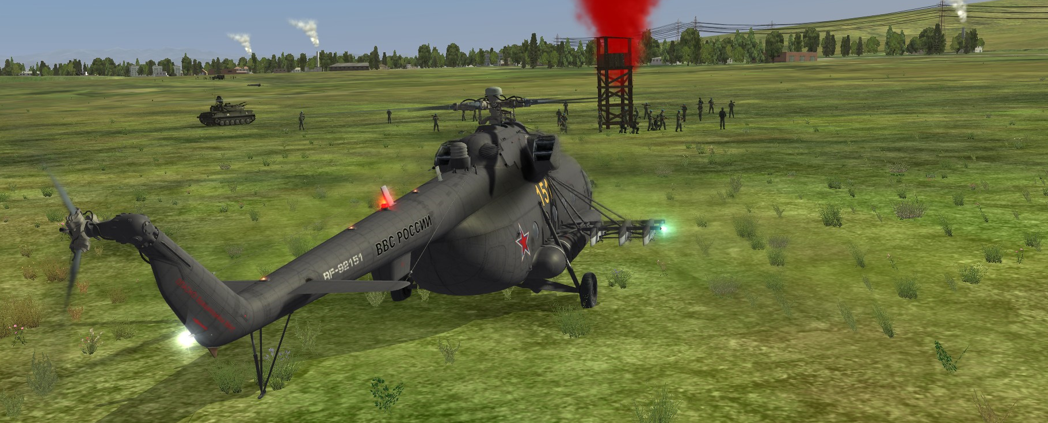
General information
Different types of cargo have different behaviour …
In order to be able to pickup or load cargo, it is required to fly within the landing zone and land the helicopter. The same counts for unloading or deploying cargo. However, each cargo has different behaviour when loading or picking up cargo:
Infantry troops runs to your stationed helicopter when loading. You need to land within a range of 100 meters from the infantry. Once the infantry received the instruction to load, and has started to run, you need to WAIT until all infantry is loaded. Beware that when infantry is under attack, the infantry will not load, but will focus on the attacking enemy or will take defensive actions.
Vehicles (only for an MI-8), will drive to the helicopter when loading. Similarly to infantry loading, you must wait before the vehicles are loaded.
Packages are delivered instantenously, there is no need to wait.
Sling loaded cargo is being handled by following the standard sling load process.
Next Page ➔

Slide 22
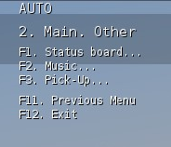
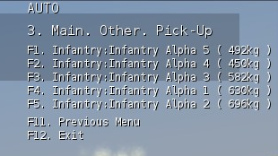
General information
Execute transport instructions using the communication menu and then selecting (F10).
During a transport flight, you will receive different instructions to load or unload packages from the helicopter. These instructions can be executed using the communication menu in DCS World. The communication menu is activated by pressing the right key on your keyboard. (default is a ‘\’). Within the communication menu, you need to press (F10) to activate further mission options.
Within the F10-Menu, options will be available to Pickup, Deploy / Load, Unload cargo, for each cargo type that is available. See next page for more info.
(Note that for transporting sling load cargo, the built-in DCS World menu system needs to be followed!)
Once you’ve selected the cargo type action menu, the next menu will show each cargo item by it’s name and weight. You can execute the action by selecting the cargo item menu.
Next Page ➔

Slide 23

Good luck!

